Slide 1
Line/Staff Authority, Empowerment and Decentralization
Session 14

Slide 2
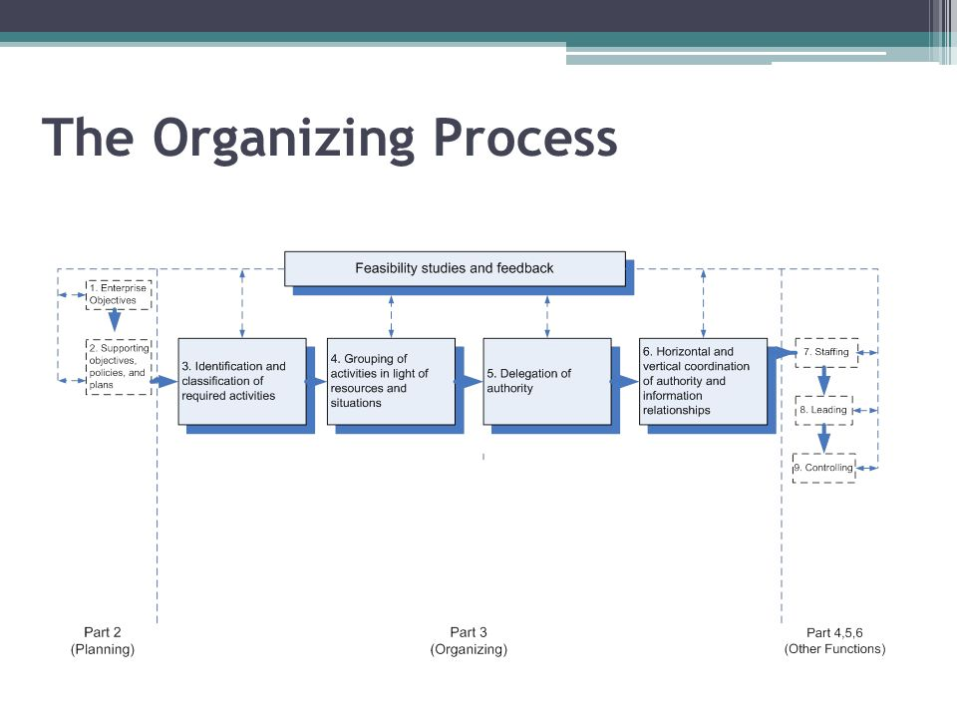

Slide 3
Questions answered
What kind of authority is found in an organization structure?
How much authority should be delegated?

Slide 4
Authority
Authority is legal and formal right to a person, who can take decisions, give orders and commands to others to perform a particular task.
It is conferred to high officials, to accomplish organization’s objectives. It is hierarchical in nature, it flows downward, i.e. delegated from superior to the subordinate.

Slide 5
In general, authority is exercised to get things done through others. It is attached to the position, i.e. any person who gets the position enjoys the authority attached to it, the higher the position, the higher would be his authority.
As the authority lies in the designation, in the absence of authority, the position offered to the person would be of no use. Moreover, it is restricted to the organisation only.

Slide 6
Power
By the term power, we mean the ability of individuals or groups to influence the beliefs and actions of other persons or groups. It is independent and informal in nature derived from charisma and status. It is an acquired ability that comes from knowledge and expertise.

Slide 7
Power is not hierarchical, i.e. it can flow in any direction like it can flow from superior to subordinate (downward) or junior to senior (upward), or between the persons working at the same level, but different departments of the same organization (horizontal), or between the persons working at different levels and departments of the same organization (diagonal). In this way, it is not confined to any boundaries.

Slide 8
Types of Power
Legitimate power
Expert power
Referent power
Reward power
Coercive power

Slide 9
Empowerment
Employees at all levels in the organization are given the power to make decisions without asking their superiors for permission.

Slide 10
Scalar principle
Classical-management rule that subordinates at every level should follow the chain of command, and communicate with their seniors only through the immediate or intermediate senior.
The clearer the line of authority, the clearer will be the responsibility for decision making and the more effective will be organizational communication.

Slide 11
Line authority
The relationship in which a superior exercises direct supervision over a subordinate.
The line manager is a person or employee of an organization who directly directs the other employees and is in charge of all the individuals working in a department. The line manager reports to the person in a position ranking higher to him.

Slide 12
Staff relationship
Is advisory
Staff managers include people who lead revenue consuming departments, for example, accounting, customer service, or human resources.
They serve the line managers of the organization in an advisory or support capacity by providing them with information and advice.

Slide 13
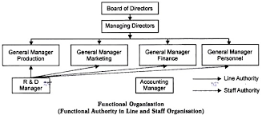
Functional authority
Functional authority is the right that is delegated to an individual or a department to control specified processes, practices, policies, or other matters in relation to activities undertaken by persons in other departments.

Slide 14
Decentralization
The tendency to disperse decision-making authority in an organized structure.

Slide 15
Centralization
It is a rule which means that the power of decision making of the organization remains under control of the top level management. It is also said that everything which decreases the role of subordinates can be termed as centralization because top level management retains everything.

Slide 16
Different kinds of centralization
Centralization of performance
Departmental centralization
Centralization of management

Slide 17
Delegation of authority
Authority is delegated when a superior gives a subordinate the freedom to decide what should be done in a particular situation to make decisions.

Slide 18
The art of delegation: Personal attitudes toward delegation
Receptiveness
Willingness to let go
Willingness to allow mistakes by subordinates
Willingness to trust subordinates
Willingness to establish and use broad controls

Slide 19
Overcoming weak delegation
Define assignments and delegate authority in light of results expected
Select the person in light of the job to be done
Maintain open lines of communication
Establish proper controls
Reward effective delegation and successful assumption of authority

Slide 20
Recentralization
Centralization of authority that was once decentralized; normally not complete reversal of decentralization, as the authority delegated is not wholly withdrawn.

Slide 21
Advantages of decentralization
Relives top management of some burden of decision making and forces upper level managers to let go.
Satisfaction of Human needs
Better Supervision And Control
Ease of Expansion
Efficient Communication
Quick Decision Making

Slide 22
Disadvantages of decentralization
Difficult To Co-Ordinate
External Factors
Narrow Product Lines
Expensive

